Slide 1
Athenahealth, Inc.
Leading cloud Based Healthcare IT Platform
Proposed Acquisitions by Bain Capital
Confidentials
Dated- November 2025
Prepared for discussion purposes only

Slide 2
Transaction Overview
Cloud-based EHR, RCM, and patient engagement software
Embedded in provider workflows → high switching costs
Subscription-based revenue model
160,000 providers on platform
Avg. revenue per provider: $11,400
Strong retention and predictable cash flows

Slide 3
Business Overview
Athenahealth Revenue Split | Values
EHR | 45%
RCM | 40%
Patient Engagement | 15%
Customers | Number of Hospitals, Practices
Net Number of Consumers | 160000
Revenue Split: EHR, RCM, Patient Engagement
Revenue mix illustrative and based on public disclosures and management estimates.

Slide 4
Healthcare IT Market
Ongoing digitalization of healthcare
Regulatory push for EHR adoption
Migration from on-premise to cloud solutions
Increasing demand for data analytics and interoperability
Industry growth sourced from third-party healthcare IT market studies.

Slide 5
Investment Thesis
Core Value Creation Levers
Recurring Revenue Stability Predictable cash flows support leverage
Revenue Growth 6–7% CAGR driven by provider adds and ARPU expansion
Margin Expansion EBITDA margin expands from 39% → 45%
FCF-Driven Deleveraging Net leverage reduced from 13.4x → 4.9x
Margin expansion assumes no major restructuring.

Slide 6
Sources and Uses
Uses | Values
Purchase Equity Value | 16400
Transaction Fees | 600
Total Uses | 17000
Sources | Values
Term Loan B | 6000
Subordinate Debt | 3500
Bain Equity | 7500
Total Sources | 17000
Sources and Uses Shows how the acquisition is funded and confirms that the LBO structure is realistic.

Slide 7
Capital Structure
Metrics | Values
Total Debt | $9.5 bn
Equity | $7.5 bn
Debt / EV | 54%
Interest rates: Term Loan ~8%, Sub Debt ~10%.

Slide 8
Operating Projections
Metrics | Value
Revenue | $1.82-$2.49 bn
EBITDA | $710mm-$1.12bn
EBITDA Margin | 39%-45%
Projections reflect Bain operating plan.

Slide 9
Debt Repayment
Strong FCF enables rapid senior debt paydown
Net leverage reduced to <5.0x by exit
Assumes 100% excess cash sweep to senior debt.

Slide 10
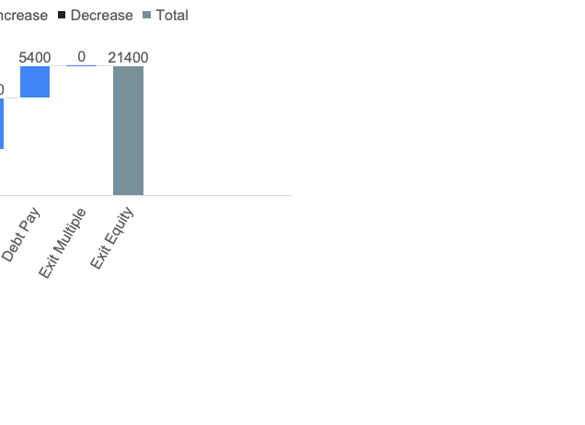
Exit & Returns
Metrics | Values
Exit EBITDA | $1.12 bn
Exit Multiples | 24.0 x
Exit EV | $26.9 bn
Exit Equity Value | $21.4 bn
Metrics | Values
MOIC | 2.9 x
IRR | 27%
Exit multiple below entry; no multiple expansion assumed.

Slide 11
Sensitivities
Exit Multiples | 22.0 x | 23.0 x | 24.0 x | 25.0 x | 26.0 x
IRR | 21% | 24% | 27% | 30% | 32%
All the Assumptions Held Constant.

Slide 12
Recommendations
Defensive growth profile with high retention
Clear operational upside in margins and efficiency
Strong free cash flow supports deleveraging
Multiple exit pathways (IPO, strategic, secondary PE)
Recommendation based on base-case underwriting.

